Slide 1
Indian Law in Wisconsin:
A Primer for Family Court Commissioners
Paul Stenzel
Deputy Family Court Commissioner, Racine County
Wausau, WI - September 14, 2017

Slide 2
Overview
Background on WI Tribes
Elementary Federal Indian law
Elementary WI Indian law (Jurisdiction)
Indian Child Welfare Act
Child Support
Concurrent actions / enforcement issues

Slide 3
Background on WI Tribes
Elementary Federal Indian law
Elementary WI Indian law (Jurisdiction)
Indian Child Welfare Act
Child Support
Concurrent actions / enforcement issues

Slide 4
11 Federally recognized Tribes in WI:
6 Chippewa bands – Bad River, Lac Courte Oreilles, Lac du Flambeau, Red Cliff, Sokaogon, St. Croix.
Stockbridge-Munsee (Mohican)
Menominee
Oneida
Ho-Chunk
Potawatomi

Slide 5
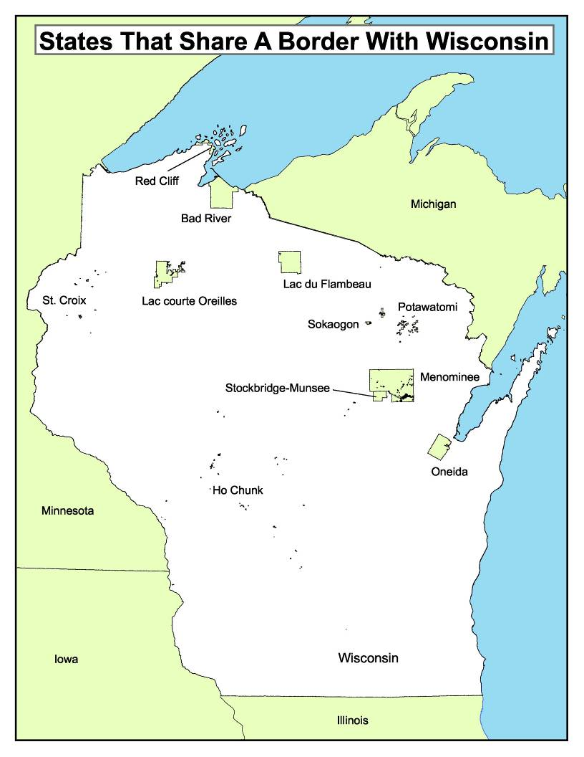

Slide 6
All tribes have a Tribal Court with varying areas of jurisdiction being exercised.
Different from state courts in that each tribe has its own substantive law.
Similar to county courts in that tribes have some similarities but each has its own local rules and practices.

Slide 7
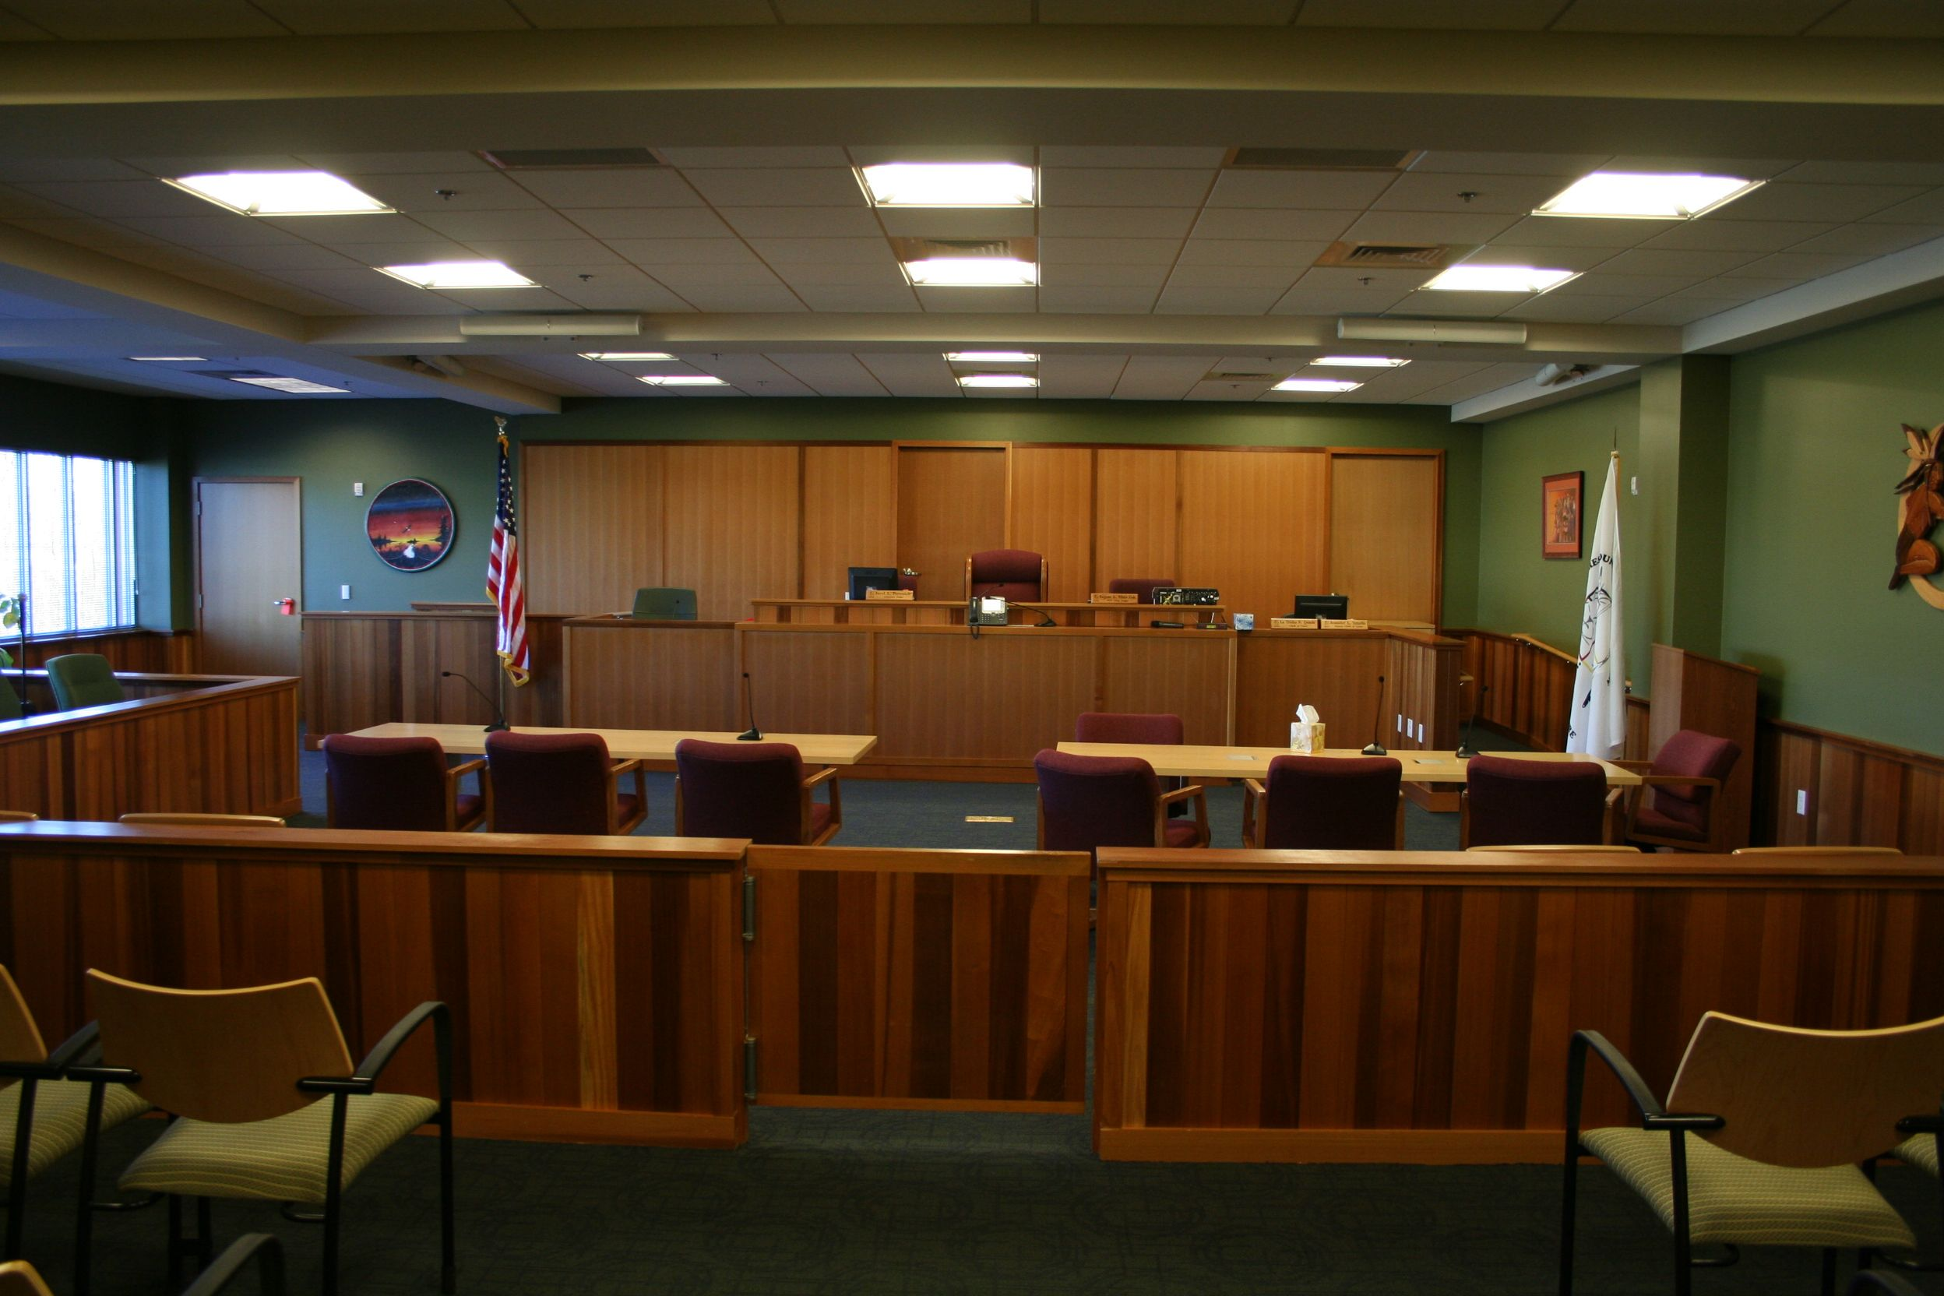

Slide 8
Background on WI Tribes
Elementary Federal Indian law
Elementary WI Indian law (Jurisdiction)
Indian Child Welfare Act
Child Support
Concurrent actions / enforcement issues

Slide 9
History of federal Indian policy:
Pre-1887: Westward expansion and relocation
1887-1943: Allotment and assimilation
1943-1960: Termination and relocation
1960-present: Self-determination

Slide 10
The United States recognizes Indian tribes as “domestic dependent nations.”
  Cherokee Nation v. Georgia, 30 U.S. (5 Pet.) 1, 17 (1831).

Slide 11
Tribes do not draw their powers from any source of federal law. Rather, they are the inherent powers of sovereigns that pre-exist the federal Union.
  United States v. Wheeler, 435 U.S. 313, 323-24 (1978); Talton v. Mayes, 163 U.S. 376, 384 (1896).

Slide 12
As such, Indian Tribes are not subject to the constitutional restraints that bind the federal government and the states. See Talton v. Mayes, 163. U.S. 376, 382-84 (1896).
However, Congress has plenary authority over Indian affairs and may impose such restraints by statute. See Washington v. Confederated Bands & Tribes of Yakima Indian Nation, 439 U.S. 466, 47-71 (1979).

Slide 13
About once per year federal government publishes list of federally recognized Indian tribes.
81 FR 5109 (Jan. 29, 2016)

Slide 14


Slide 15
Background on WI Tribes
Elementary Federal Indian law
Elementary WI Indian law (Jurisdiction)
Indian Child Welfare Act
Child Support
Concurrent actions / enforcement issues

Slide 16
In 1953 Congress enacted what is known as Public Law 280. That statute designated that certain states would have jurisdiction over Indian tribes.
Up until then, state jurisdiction on reservations was very limited.

Slide 17
Under Public Law 280, Wisconsin granted concurrent criminal jurisdiction on Indian reservations. (Except Menominee).
Regarding civil jurisdiction, Wisconsin has civil adjudicatory jurisdiction. (As opposed to civil regulatory.) See Bryan v. Itasca County, 426 U.S. 373 (1976).

Slide 18
Although there have not been any litigated cases in Wisconsin, with respect to family law, there is little question Wisconsin courts have civil adjudicatory jurisdiction over family matters.

Slide 19
However, a couple of cases suggest that if a Tribe has its own family law enacted, state courts should defer.
County of Vilas v. Chapman, 122 Wis. 2d 211 (1985)
St. Germaine v. Chapman, 178 Wis. 2d 869 (Ct. App. 1993).

Slide 20
Background on WI Tribes
Elementary Federal Indian law
Elementary WI Indian law (Jurisdiction)
Indian Child Welfare Act
Child Support
Enforcement in Tribal Court

Slide 21
The Indian Child Welfare Act (ICWA), 25 USC §§1901 et seq. governs state action to remove an Indian child from the home.
Wisconsin adopted its own version in Wis. Stat. § 48.028 (Enacted in 2009).
For purposes of family court, important to know that ICWA does not apply to custody proceedings between parents. See Wis. Stat. 48.028(d) and 25 USC 1903(1).

Slide 22
The most common application is in CHIPs and TPR proceedings. In those cases, Indian tribes must be noticed if the child at issue is a member or eligible for membership in an Indian tribe.
Once the ICWA applies, special rules apply:
  Tribe can intervene
  Case can be transferred to tribal court
  Preferences on placement
  Higher burden of proof

Slide 23
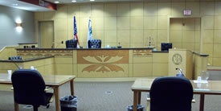

Slide 24
Background on WI Tribes
Elementary Federal Indian law
Elementary WI Indian law (Jurisdiction)
Indian Child Welfare Act
Child support
Concurrent jurisdiction / enforcement issues

Slide 25
Some Tribes make per capita payments to their members. In Wisconsin, these are usually for higher-income tribes who make income from gaming and choose to distribute money to tribal members (not required to).
  Amounts and frequency of payment varies (annual, quarterly, bi-weekly).
  Per capita payments are considered income and subject to federal income tax. (And thus subject to use in income determination).
  Most tribes have a their own procedure for per capita payments to be garnished for child support.

Slide 26
As part of welfare reform in 1996, Congress permitted Tribes to directly receive IV-D funding and establish their own IV-D departments.
Nearly all tribes have established or are in implementation stages for their own IV-D programs.
Tribes and states have to give each other full faith and credit under 28 USC 1738B.

Slide 27
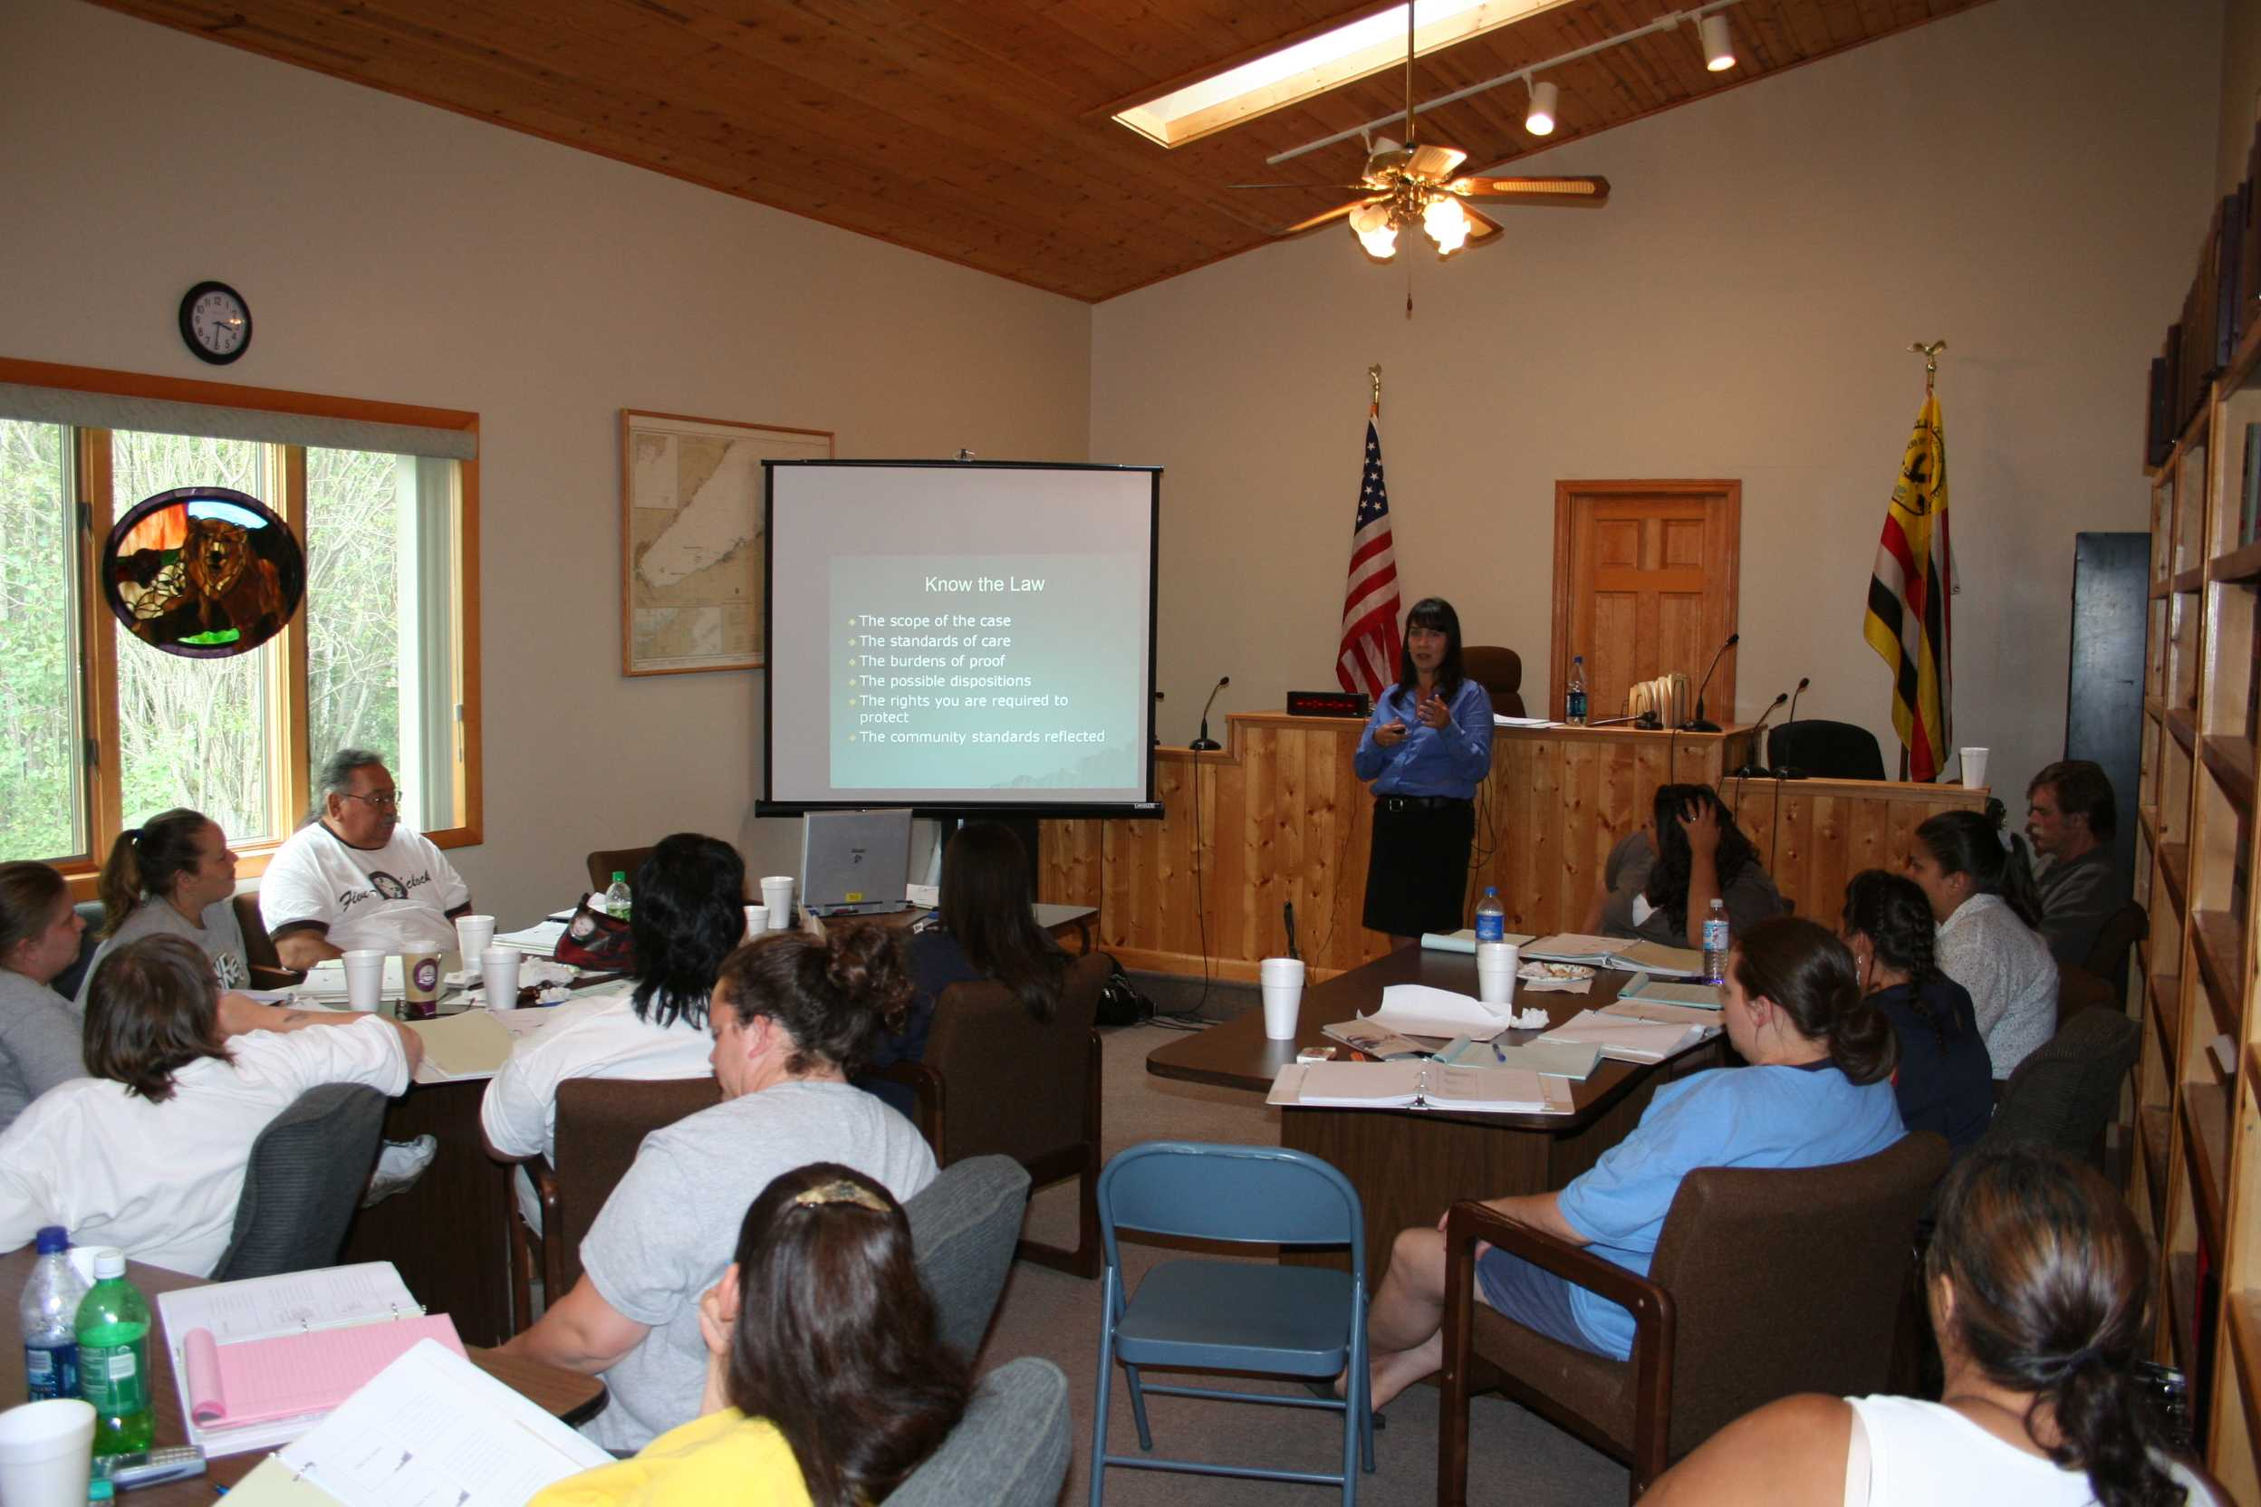

Slide 28
Background on WI Tribes
Elementary Federal Indian law
Elementary WI Indian law (Jurisdiction)
Indian Child Welfare Act
Per capita payments
Concurrent actions / enforcement issues

Slide 29
Recognition of state court family orders by tribal jurisdictions varies.
Wisconsin requires state courts to recognize Indian tribes as states for purposes of UCCJEA. (See Wis. Stat. § 822.04)
Wis. Stat. § 806.245 requires state courts to give full faith and credit to tribal court judgments.
Wis. Stat. § 806.247 applies enacts VAWA requirements for protective orders.

Slide 30
Recall that under Public Law 280, states have concurrent jurisdiction with tribes over civil adjudicatory issues.
From time to time state and tribal court jurisdiction overlap with each other. Parties may forum shop.
Issue came to a head in Teague v. Bad River Band, 2003 WI 118.

Slide 31
Teague was an employment case, but the rule applies to any type of subject matter area.
When a state and tribal court have concurrent jurisdiction, the judges shall hold a hearing on the record and then confer to decide how to allocate jurisdiction based on factors enumerated in case. 2003 WI 118 at ¶ 71. (Factors are based on comity.)

Slide 32
After Teague, new era of state and tribal court collaboration, particularly in the northern half of the state.
Wisconsin Supreme Court enacted Wis. Stat. sec. 801.54 which permits state courts to transfer a case to a tribal court in the appropriate situation.

Slide 33
This was a cursory review of some complex issues:
Recommended follow up reading:
American Indian Law in a Nutshell, 6th ed. (West)
Cohen’s Handbook of Federal Indian Law, 2005 Edition (LexisNexis)

Slide 34
You can find a lot more outlines and materials about Indian law on various topics at: www.paulstenzel.com
Contact me at:
paul.stenzel@wicourts.gov

